Slide 1

Reconstructing Perceived Images from Human Brain Activities using TWIN DEEP NEURAL NETWORK
Domain : Machine Learning and Neuroscience
Team Members
KEDAR R (211417104117)
MOHANAVEL R (211417104149)
PIYUSH CHOUHAN M (211417104183)
Guided by
Dr. N. Pughazendi,
Professor,
Panimalar Engineering College

Slide 2
introduction
Understanding visual processing of human brain is critical and challenging problem in old days. Revolution of mathematical and probabilistic models in computer field are applied to many sorts of applications including detection, computer vision, classification problems.
Auto encoders is basic generative model to capture important feature without conflicting the originality of data and can able to derive the high dimension data using by neural network.
Neural encoding means to forecast the voxel activation from the visual stimuli and vice versa is named as neural decoding.

Slide 3
literature survey
TITLE | OBJECTIVE | METHODOLOGY & OUTCOME
Multispectral Image Reconstruction From Color Images Using Enhanced Variational Autoencoder and Generative Adversarial Network | Combining the advantages of the Generative adversarial Network (GAN) and the Variational Autoencoder(VAE). | One input image with random latent space vectors can be created out of the lost possible multiple outputs. Even with less training data they got accurate and quality reconstructed results.
3D Contrast Image Reconstruction from Human Brain Activity | Reconstruct 3D visual images by constructing three decoding models are contrast-decoding, disparity decoding and contrast-disparity-decoding models, and testing these models with fMRI data from humans viewing 3D contrast images. | The outputs of the decoders were combined by a linear model of the corresponding local image elements using the same method to reconstruct contrast images. The combination of the early and dorsal visual regions showed predominant advantages in decoding both the contrast and disparity for the contrast-disparity decoding model

Slide 4
PROBLEM STATEMENT
Neural Decoding plays an important role in understanding Human Visual System.
Human visual system is naturally capable of extracting features from any object and comparing them. Most of the papers focus on either the brain activity pattern classiﬁcation or visual stimuli identiﬁcation.
In this project, we introduce Twin Deep Neural Network model for accurate reconstruction of images from human brain activity using Functional Magnetic Resonance Imaging (FMRI).
TDNN method can be used for comparing the relationship between a sample pair of similar features for better visual reconstruction and make use of each sample completely.
High dimensionality and small quantity of FMRI data impose restrictions is reduced by using TDNN approach.
Essentially, this manner can increase the training data about from N samples to 2N sample pairs, which takes full advantage of the limited quantity of training samples.
We evaluated the proposed TDNN method on the open dataset of handwritten digital images and character dataset, and exceeded about 10% than the accuracy of all existing state-of-the-art methods on the Convolutional Neural Network (CNN).

Slide 5
Dataset creation process

Slide 6



Technology stack
Jupyter Notebook
Keras & Scipy
Python
Virtual Environment

Slide 7
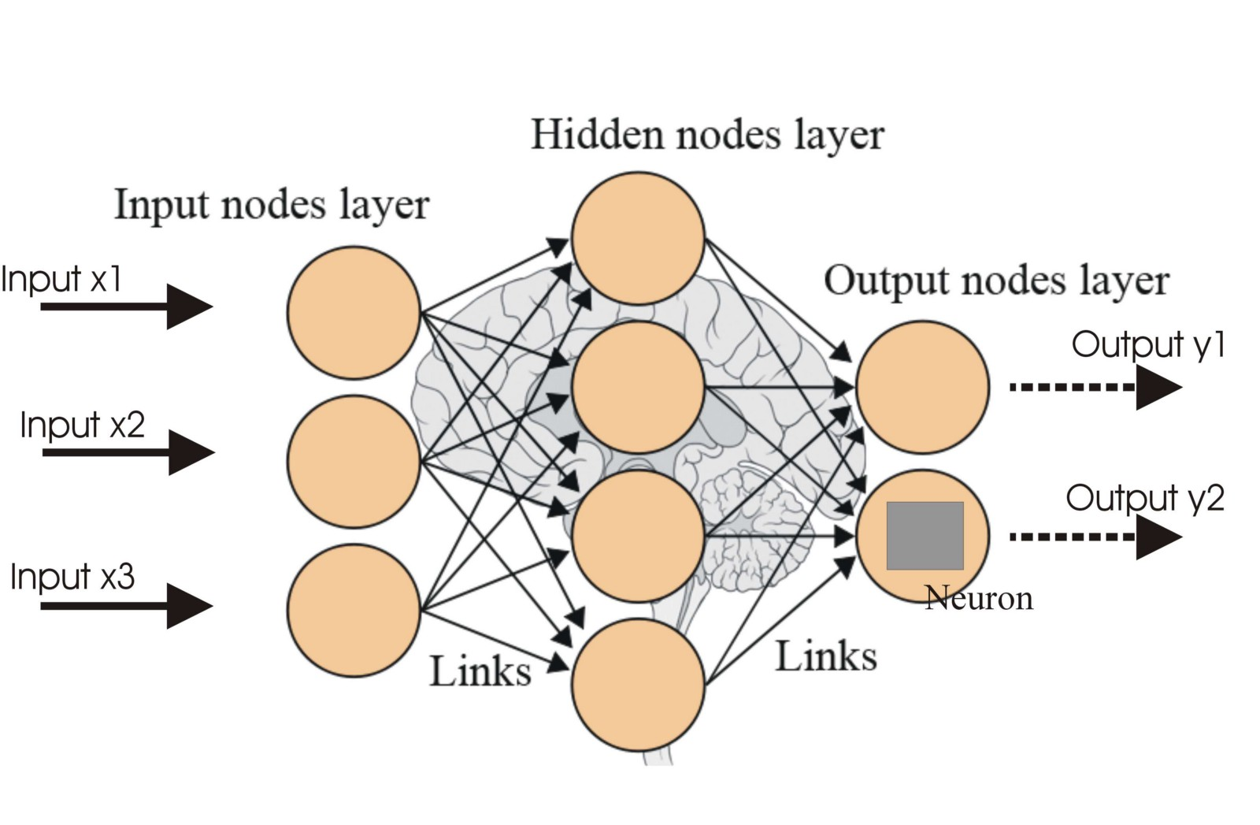





Technology stack
POST DATA
REST API CALLS
PYTHON FLASK
DEEP LEARNING
ANGULAR
RESPONSE
Job Roles :
Kedar – Frontend Development
Mohanavel & Piyush Chouhan – Machine Learning & Back-end Development

Slide 8
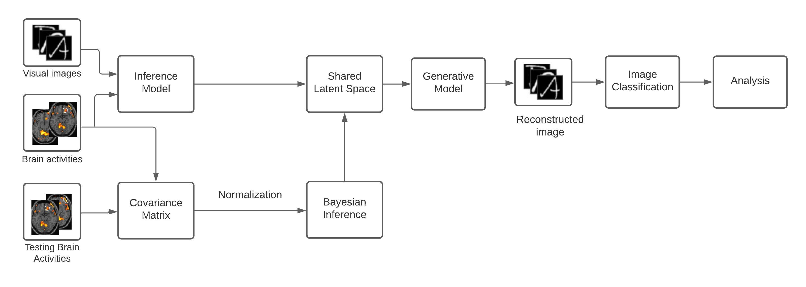
Architecture diagram

Slide 9
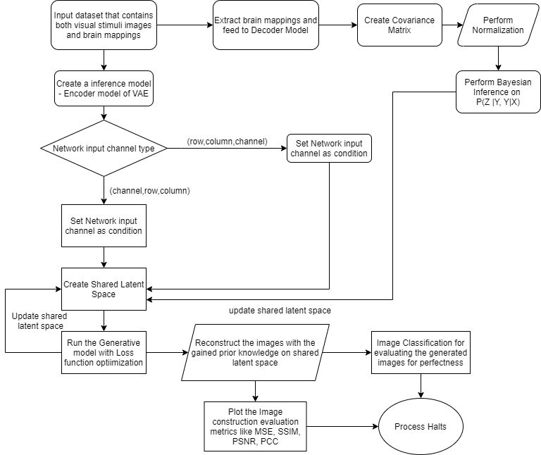
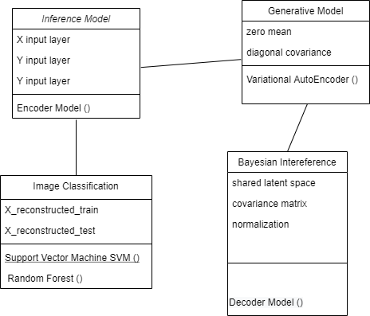
Class diagram activity Diagram

Slide 10
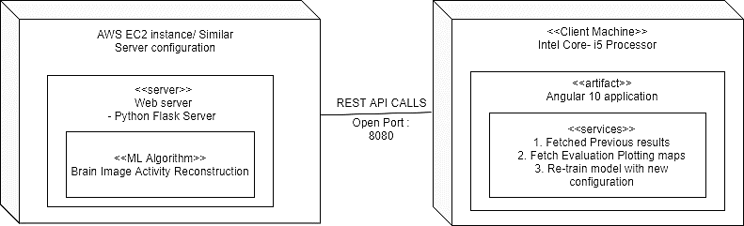
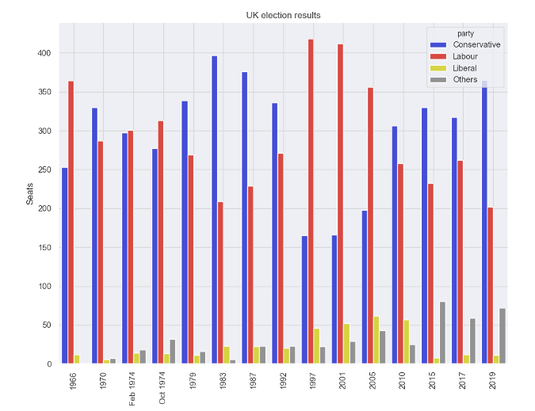



Deployment diagram

Slide 11
MODULES derived
Inference Model – Encoder network of VAE to encode the training images
Shared Latent Space – a common space consisting of the encoded data of visual stimuli and brain mappings
Covariance Matrix – a relationship mapping matrix model for finding relation between the images and the brain mappings
Generative Model – a neural network that generates the images with the help of shared latent space
Image classification – Evaluation module for performing the quality check on the image reconstructed

Slide 12
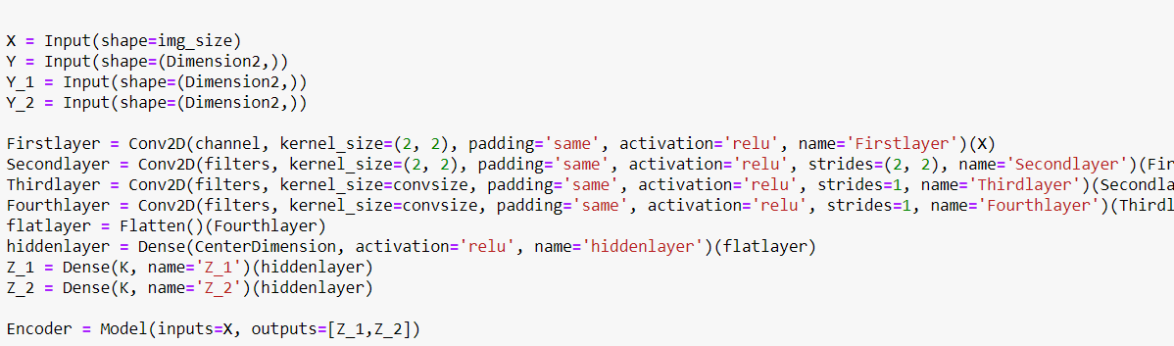
Inference model
A neural network model that can encode the train data to concise mappings
To achieve this functionality, we make use of the Encoder network of the Variational AutoEncoder (VAE)
Here, the network performs a compression mechanism mappings which is achieved with the help of Dimensionality reduction

Slide 13
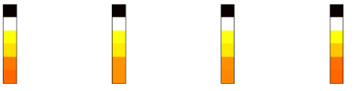
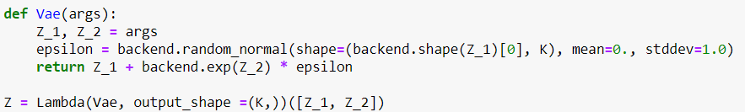
Shared latent space
This is a common space which is used to store the inferred knowledge from the inference model
It is updated on every epoch of the training phase and also updated by the testing phase
This enhances the proximity to correctly determine the relations between the images and brain mappings.

Slide 14
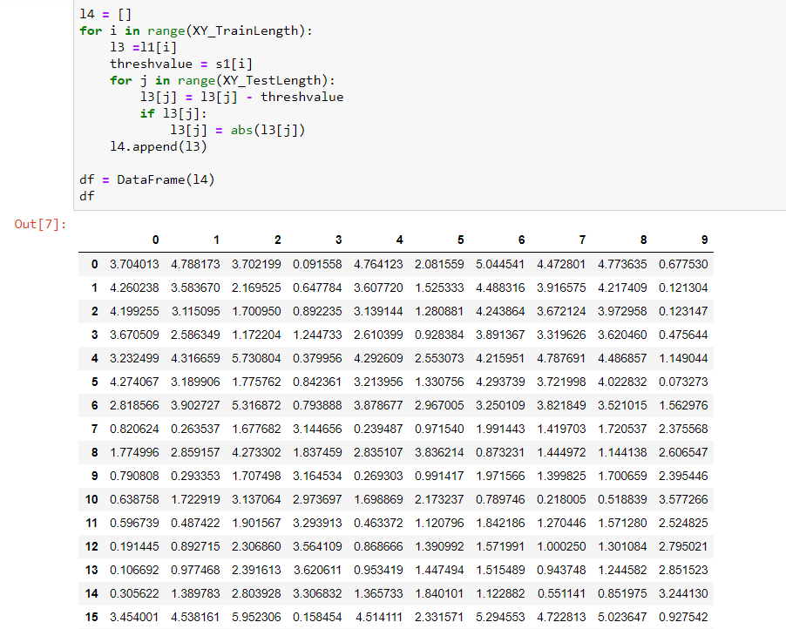
Covariance matrix
The covariance matrix is the one that will store the relations among the images and brain mappings during the testing phase.
In testing, the covariance matrix is created for the input dataset and it is normalized
To create this matrix, we use KNN to find the closest neighbor and using this neighbor, we compute the distance. Once distance is computed, we then use the Dimensionality reduction.

Slide 15
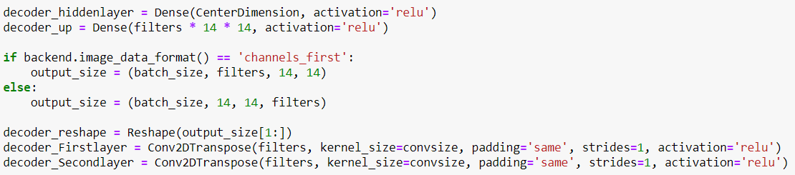
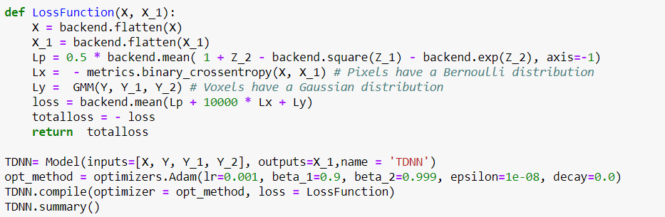
Generative model - tdnn
This Module is responsible for reconstructing images from the Shared Latent Space.
It takes input from the Shared Latent Space which is in the form of smaller dimensions and convert it into images of larger dimensions.
There are many algorithms for the generation of images from the Latent Space Vector namely, Generative Adversarial Networks (GAN), Variation Auto Encoder (VAE) and Convolutional Neural Network (CNN).

Slide 16
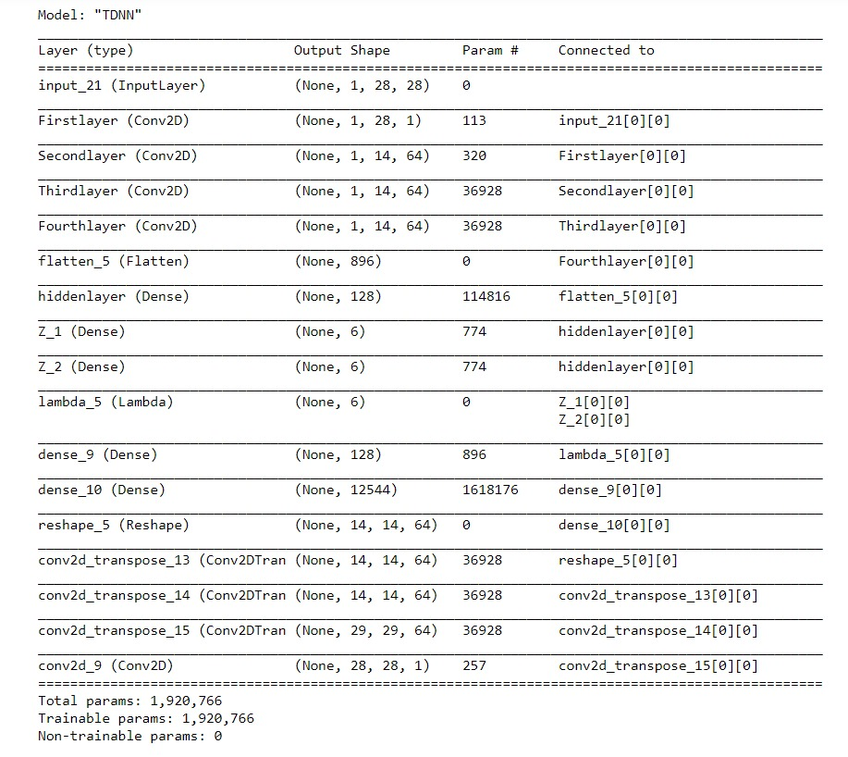
Convolutional neural network - cnn

Slide 17
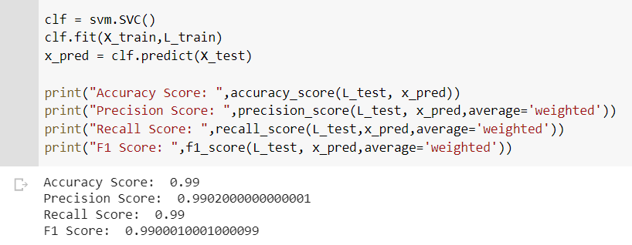
Image classification
Image Classification refers to labelling of images into one of the number of predefined classes.
There are n number of classes in which a given image can be classified.
There are many classification algorithms such as Support Vector Machine(SVM), Random Forest.
Effective on datasets with multiple features, so we are using SVM classifier for an image classification.
SVM algorithm is chosen to classify the reconstructed images because of small number of classes.
Image Classification refers to labelling of images into one of the number of predefined classes.
There are n number of classes in which a given image can be classified.
There are many classification algorithms such as Support Vector Machine(SVM), Random Forest, Decision Tree.
SVM algorithm to classify the reconstructed images because of small number of classes.

Slide 18
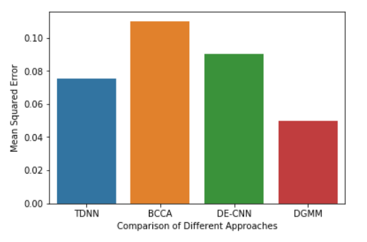
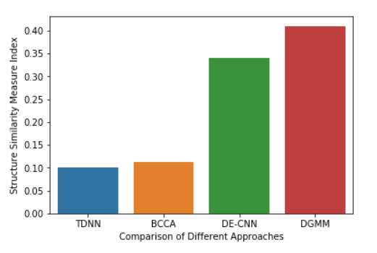
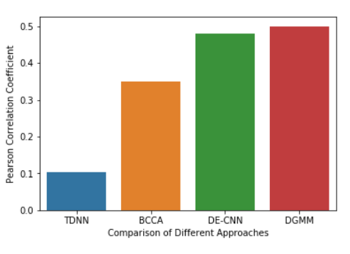
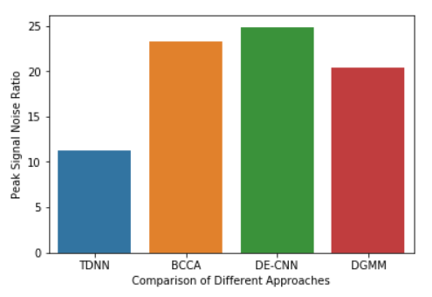
Evaluation Metrics
Mean Squared Error (MSE)
Structured Similarity Index (SSIM)
Pearson Correlation Coefficient (PCC)
Peak Signal Noise Ratio (PSNR)

Slide 19
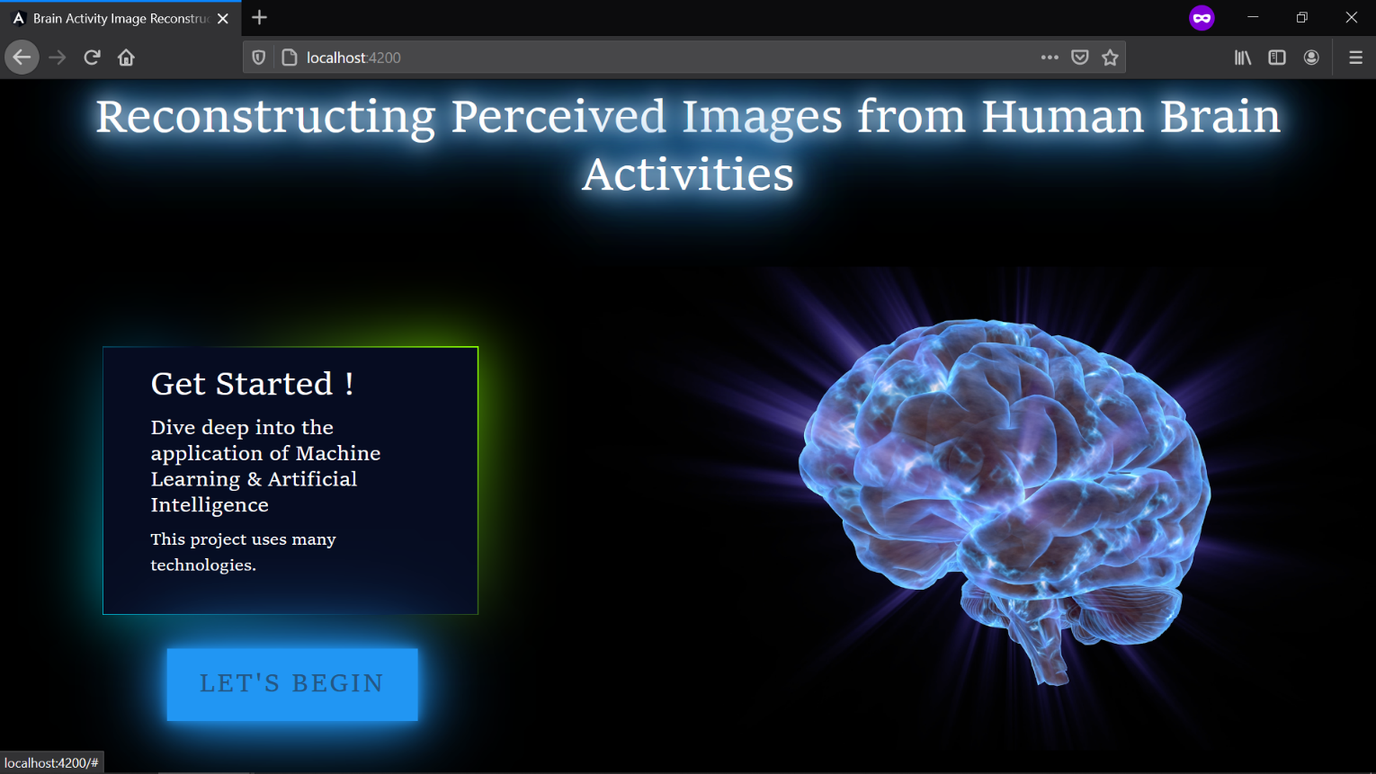
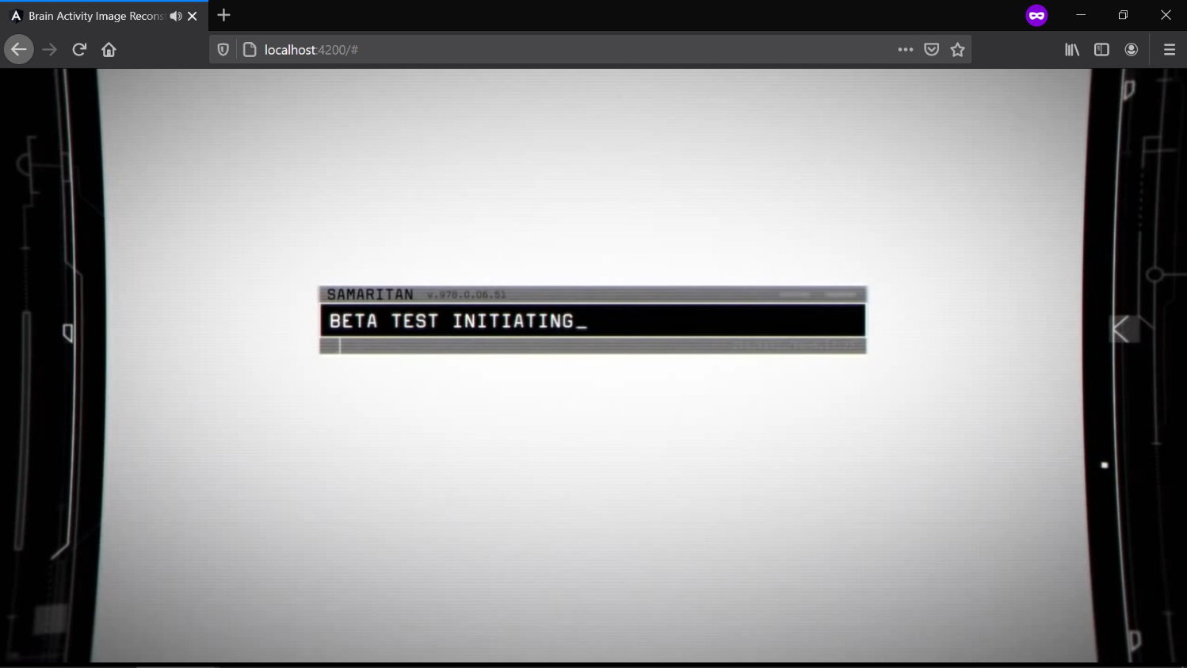
SCREEN CAPTURES

Slide 20

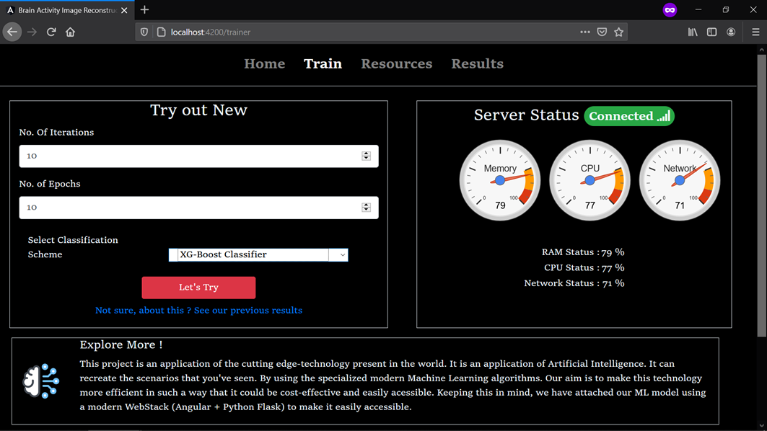
SCREEN CAPTURES

Slide 21

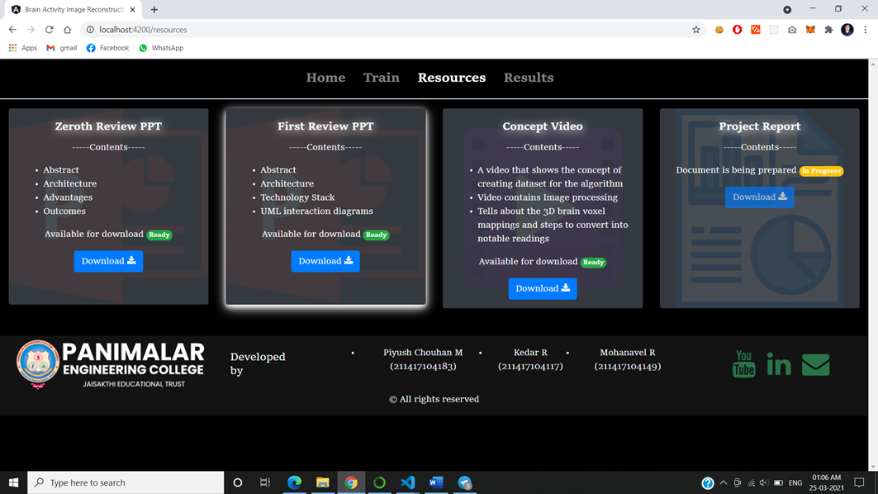
SCREEN CAPTURES

Slide 22
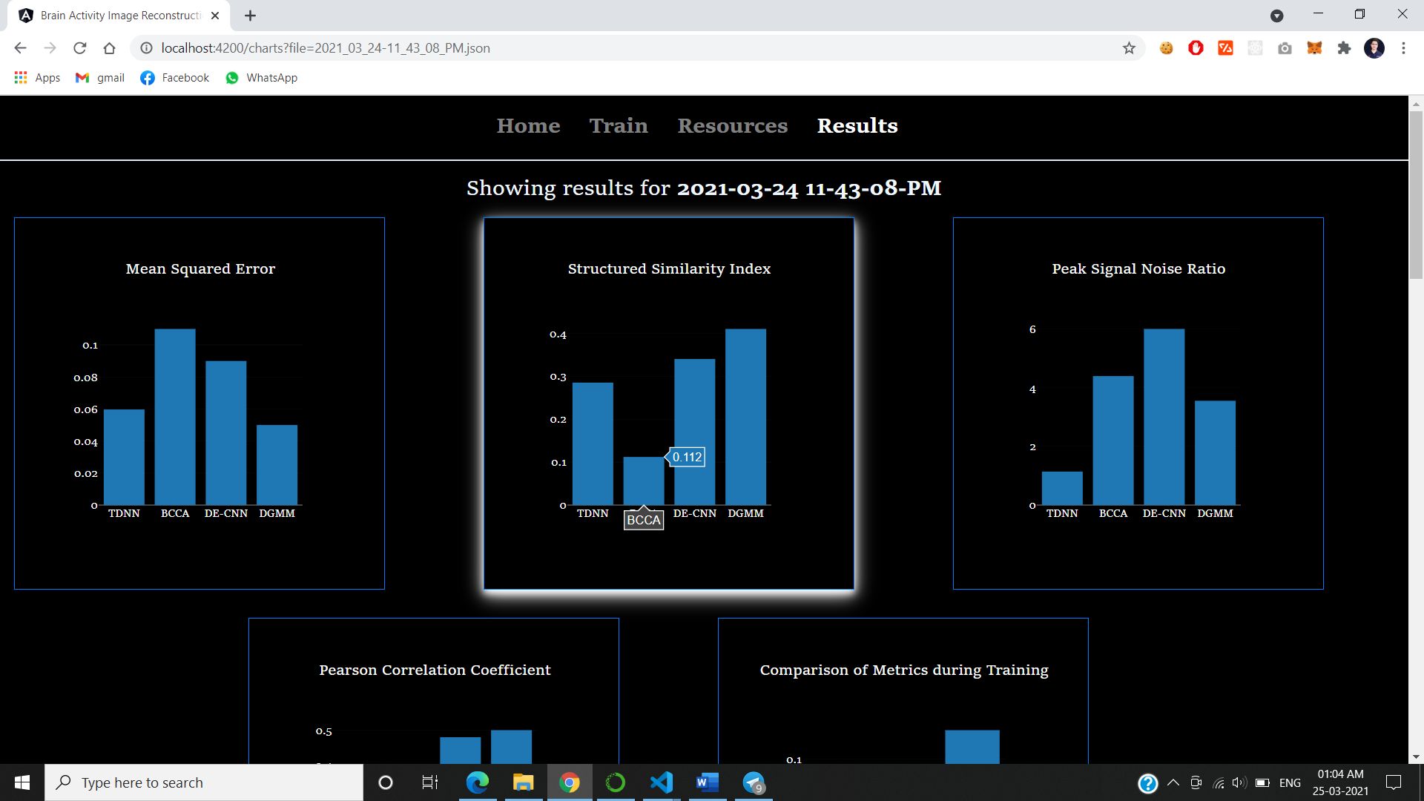
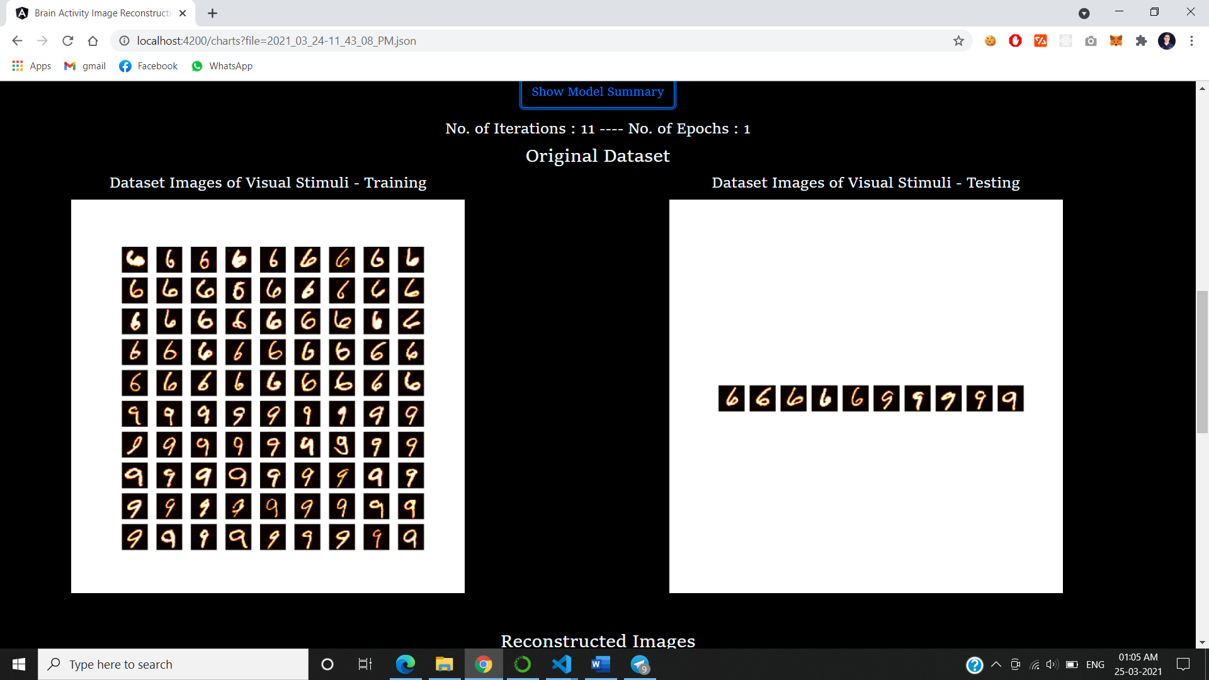
SCREEN CAPTURES

Slide 23
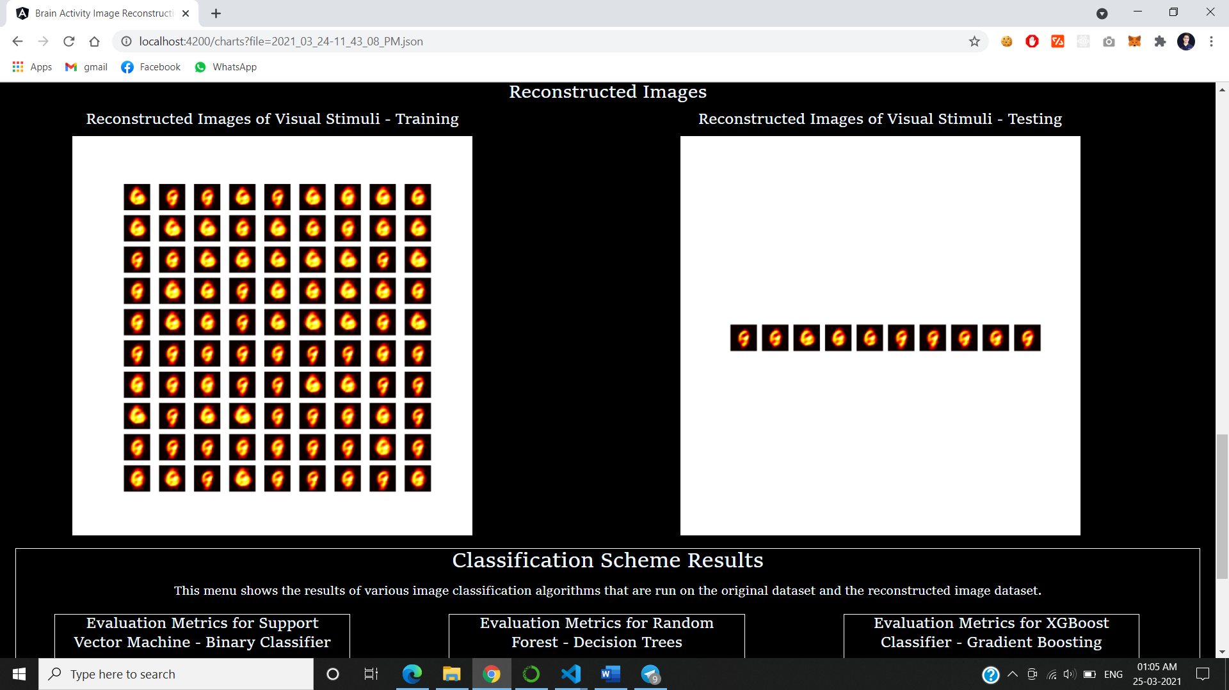
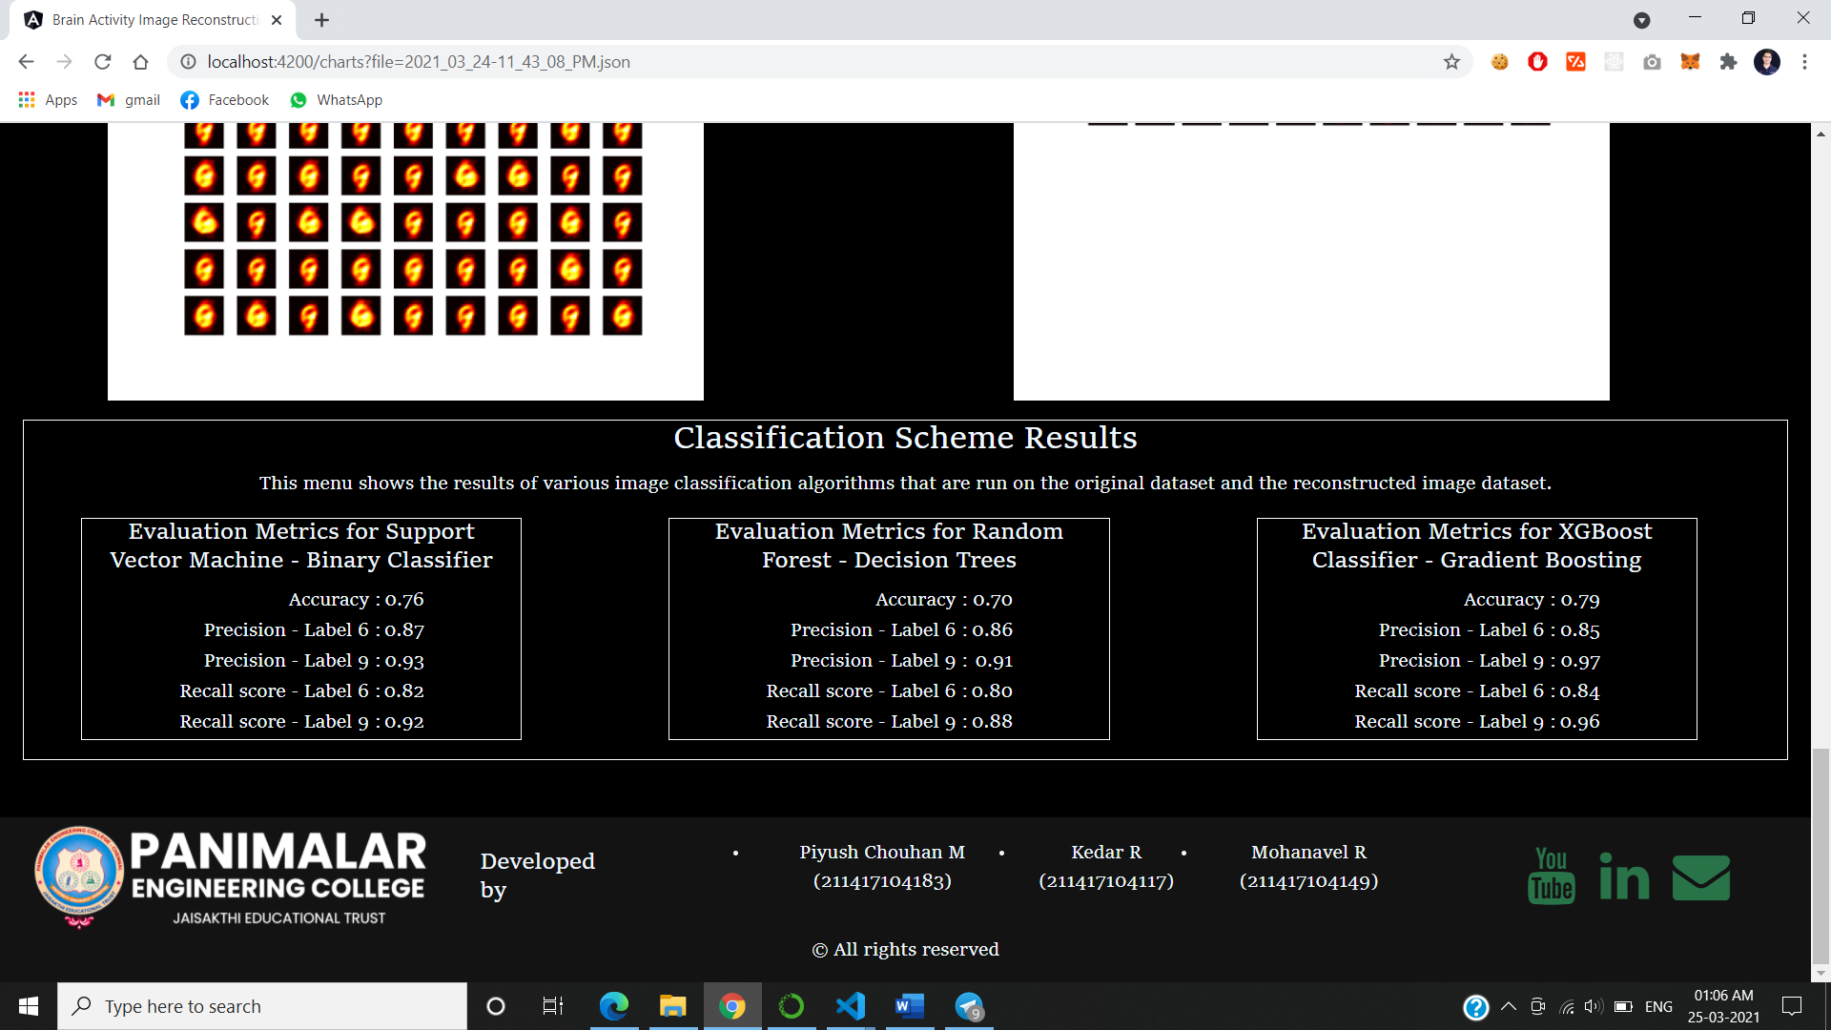
SCREEN CAPTURES

Slide 24
CONCLUSION
This will help the neurologist to better understand the health conditions of a paralyzed patient.
It can be evolved to produce the dream visuals of a person which is still a mystery to solve. This can open doors to several mysteries behind neurology. Still we are at 21st century but storing and playing a dream is still a issue.
With the help of this technology, we can be able to reconstruct the dream using Generative Adversarial Neural network (GAN) networks.

Slide 25
REFERENCES
Changde du, Huiguang, Lijie huan, “Reconstructing Perceived Images from Human Brain Activities with Bayesian Deep Multiview Learning.” IEEE Transactions on Neural Network and Learning Systems, 8 August 2019.
Eero p. simoncelli, Irene epifanio, Jesus malo and Rafael Navarro, “Nonlinear Image Representation for Efficient Perceptual Coding” IEEE Transactions on Image Processing, VOL. 15, NO. 1, January 2006.
Floris de lange, Marcel van gervan and Tom heskes, “Neural Decoding with Hierarchical Generative Models” P1: QPU NECO_a_00047-Gerven NECO.cls September 8, 2010.
Gomathi, Rathi “Human Vision Reconstruction using Brain Activity Profiles” 2018 4th International Conference on Computing Communication and Automation (ICCCA).

Slide 26
COPYRIGHT
Title : Reconstructing Perceived Images from Human Brain Activities using TWIN DEEP NEURAL NETWORK
Diary Number : 11919/2021-CO/L
Register Number : L-104847/2021
Status : Registered
Date : 2 July 2021

Slide 27

Thank You

